Slide 1
Lighting/Illumination/Reflection Model

Slide 2
Some of the contents used in this lecture belong to…
Dr Jon Shiach, Manchester Metropolitan University, “Direct Lighting Model”, https://www.youtube.com/watch?v=7CdS8oOJtVA
Mr. Jacobson, University of Toronto, “WebGL Phong Shading”,
http://www.cs.toronto.edu/~jacobson/phong-demo/ (Online demo)

Slide 3
Basic Terms
Illumination: the transport of energy from light sources to surfaces & points
Local illumination
Global illumination
Lighting model or Illumination model: Express the factors determining a surface’s color or luminous intensity (outgoing or reflected light) at a particular 3D point
Notes:
We calculate intensity of a point (light reflected from that point)

Slide 4

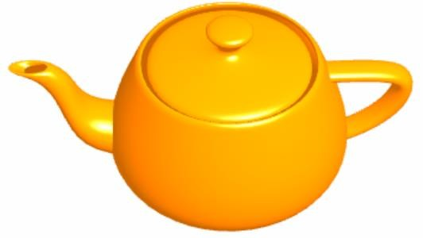
Effects of Lighting
Pixel color only
Pixel colors with lighting

Slide 5
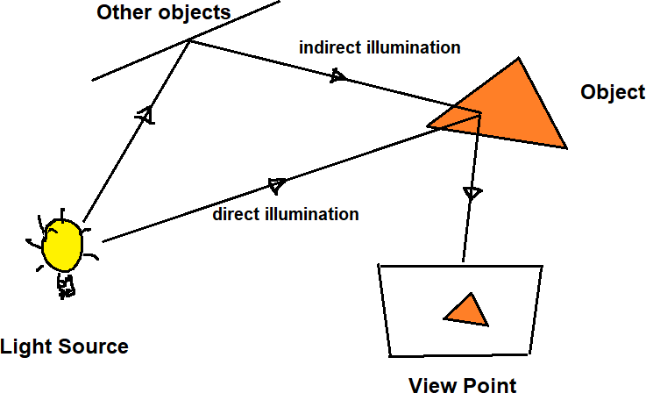
Illumination

Slide 6
Components of Illumination
Two components of illumination:
Light sources
Surface properties
Light source described by a luminance/intensity ‘I’
Each color is described separately
I = [Ir Ig Ib]
Types of Light Sources:
Ambient Light
Diffuse Light
Spot Light

Slide 7
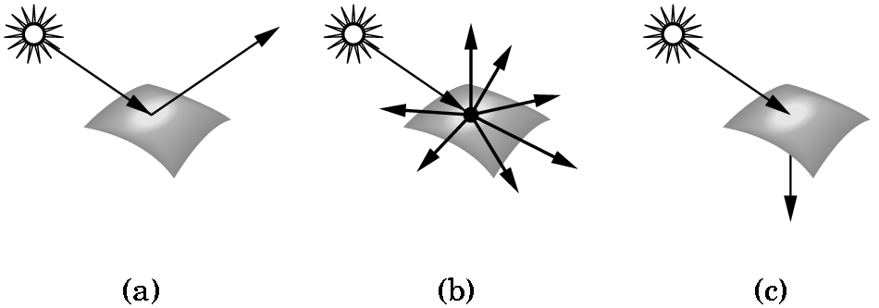
Types of Surface
Interaction between light and material can be classified as
Specular surfaces – Ideal mirror
Diffuse surfaces – Reflected light is ideally reflected to all directions uniformly
Translucent surfaces – Allow some lights to penetrate the surface (e.g. refraction in glass, water)
Notes:
So far what we have seen is the intensity of incident light at some surface point. Now we will compute intensity of reflected light at some surface point.
Assumption: incident light is fully reflected

Slide 8

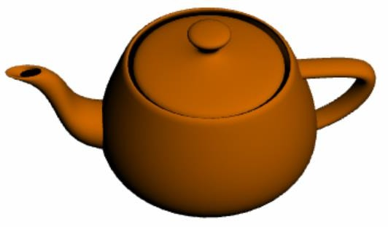
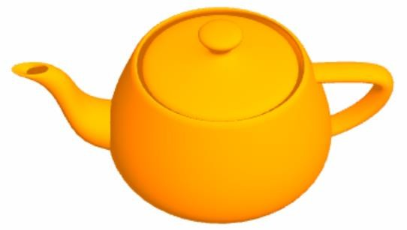
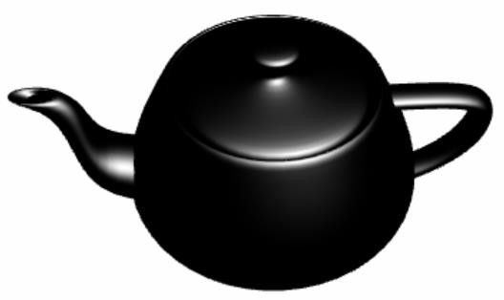
Phong’s Reflection Model
+
=
+
Ambient Light
Diffuse Light
Specular Light

Slide 9
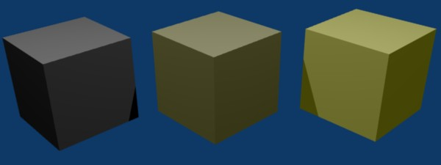
Ambient Light
No identifiable source or direction
Product of multiple reflections of light from the many surfaces present in the environment
Computationally inexpensive
Notes:
The scenes we observe around us always seem to be bathed in some soft non-directional light 🡪 Ambient light

Slide 10
Ambient Light
Categories:
Global ambient light
Independent of light source
Lights entire scene
Example: reflection of sunlight from several surfaces
Local ambient light
Contributed by additional light sources
Can be different for each light and primary color
Example: Reflection of fluorescent lamps from several surfaces
Notes:
Global ambient light – sunlight comes through window, get reflected from several surfaces
Local ambient light – tube light get reflected from several surface

Slide 11
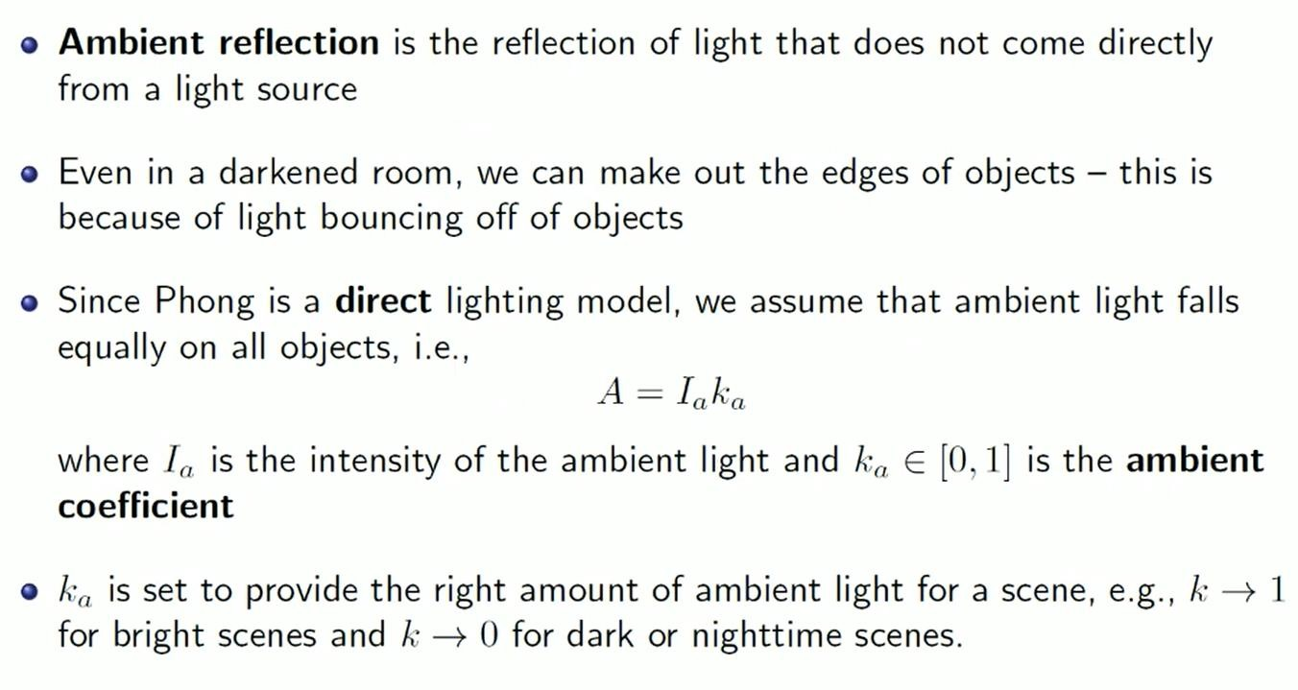





Ambient Reflection
k_{a}=1
k_{a}=0

Slide 12
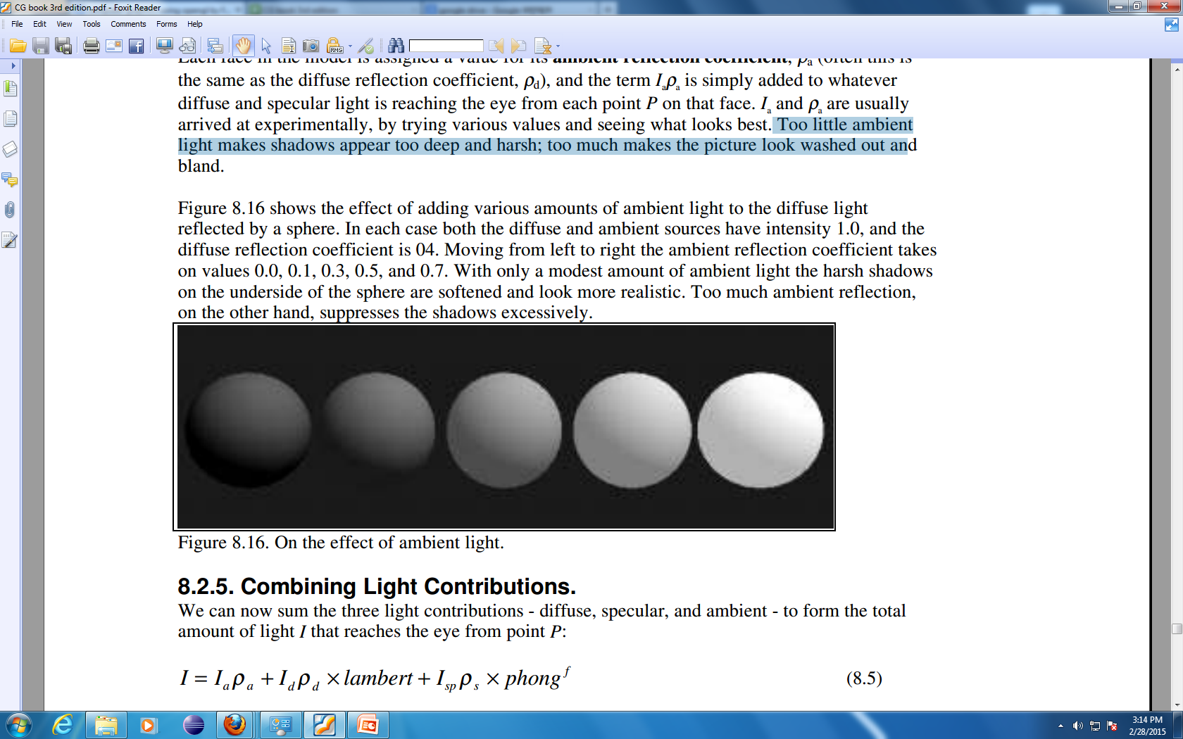
Ambient Reflection Coefficient
Effect of adding ambient light to the diffuse light reflected by a sphere
Diffuse source intensity is 1.0 Diffuse reflection coefficient is 0.4 Ambient source intensity is 1.0
Moving from left to right the ambient reflection coefficient takes on values: 0.0, 0.1, 0.3, 0.5, and 0.7
Too little ambient light makes shadows too deep and harsh
Too much makes the picture look washed out and bland

Slide 13
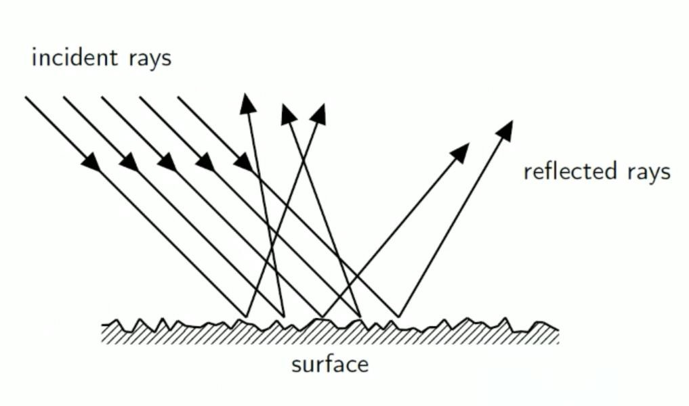
Diffuse Reflection
Result of irregular reflection of light
Light is scattered in all direction. Not all are visible
Does Not depend on the position of viewpoint

Slide 14
Ambient Light vs Diffuse Light
Diffuse light
Ambient Light

Slide 15

Ideal Diffuse Reflection
Assumes surface reflects equally in all directions.
An ideal diffuse surface is, at the microscopic level, a very rough surface.
Example: chalk, clay, some paints
Surface

Slide 16
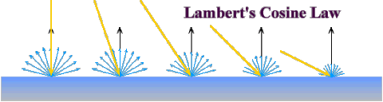
Ideal Diffuse Reflection
Ideal diffuse reflectors reflect light according to Lambert's cosine law.
Lambert's law determines how much of the incoming light energy is reflected. The reflected intensity is independent of the viewing direction.
But reflected light intensity depends on incident angle of light.

Slide 17
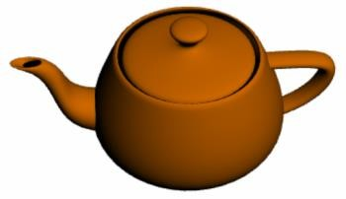
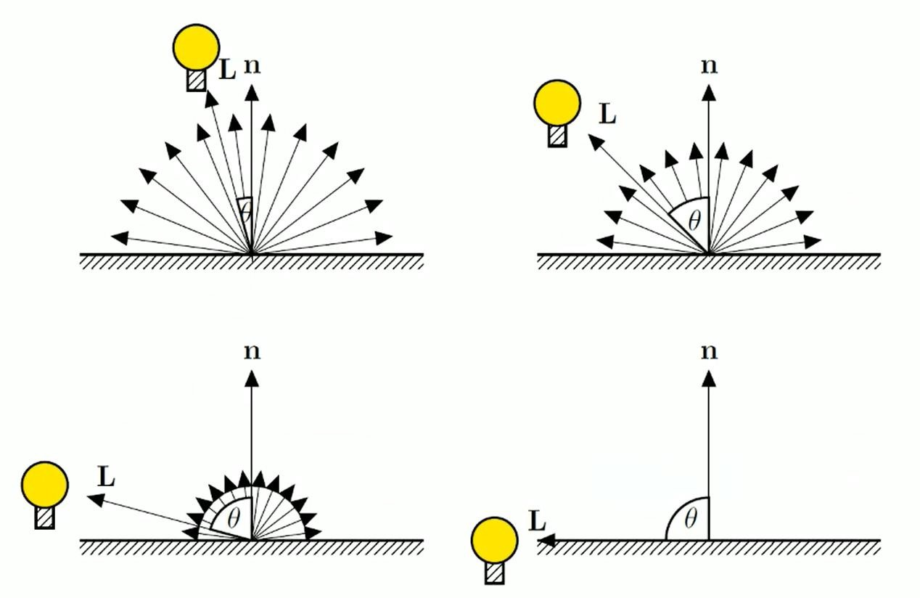
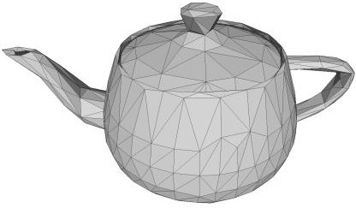

Diffuse Reflection (Phong’s Model)
Light reflected equally in all direction.
Magnitude of reflection depends in incident angle.
Direction of L reversed? Why?

Slide 18
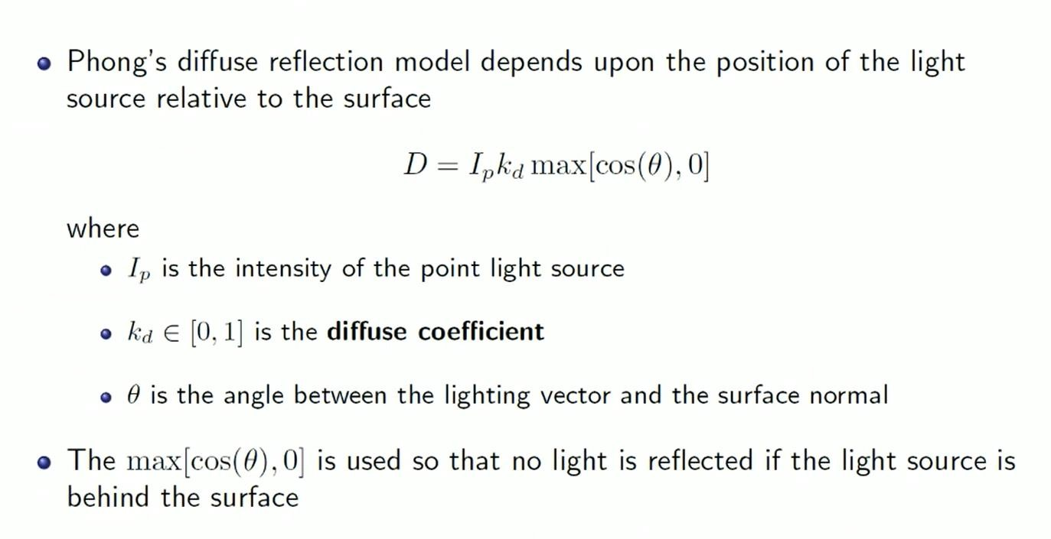
Diffuse Reflection - Phong’s Model

Slide 19
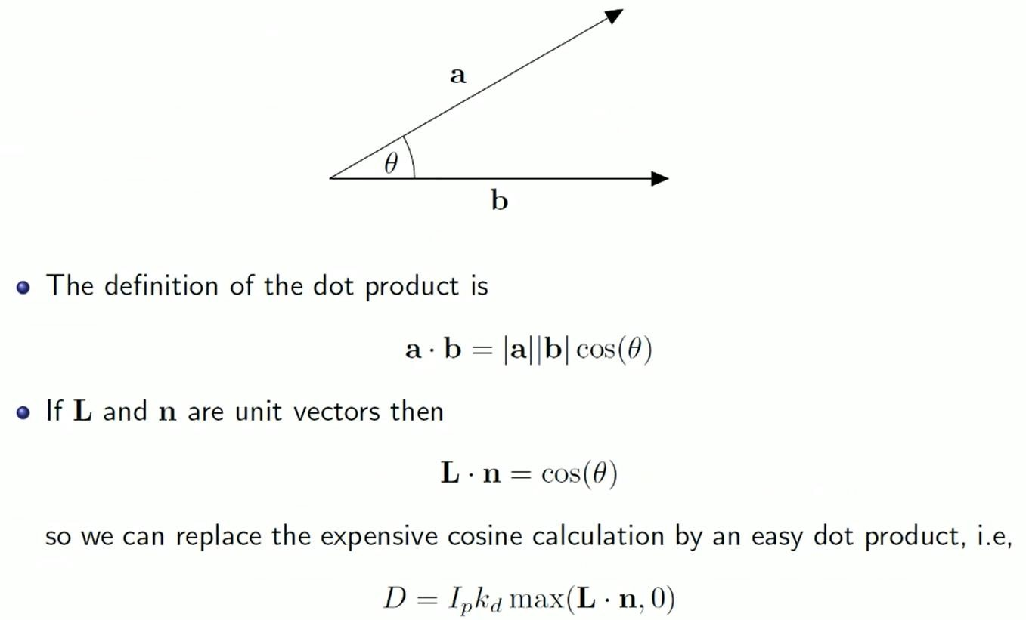
Diffuse Reflection
Here L and n are both unit vectors

Slide 20
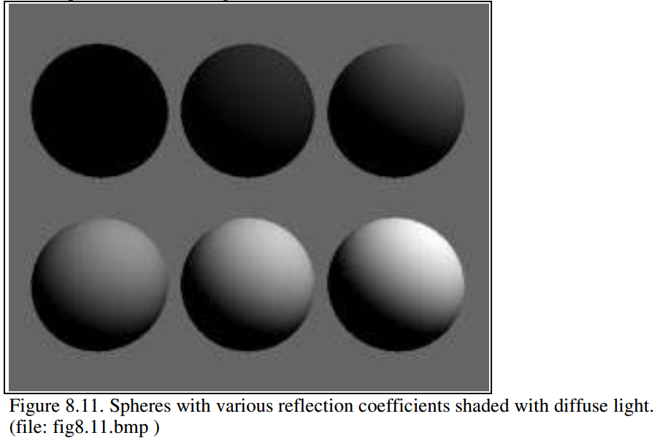
Diffuse Reflection Coefficient
I_{d} = max {I_{s} k_{d} cosθ, 0}
Source intensity is 1.0
Background intensity is 0.4
Sphere reflecting diffuse light, for six reflection coefficients: 0, 0.2, 0.4, 0.6, 0.8, and 1.
Angle θ between surface normal and incident light is > 90º
What is the ambient component here?
What is the specular component?
Notes:
Note that the sphere is totally black when kd is 0.0,
the shadow in its bottom half is also black. Since there the angle between surface normal and incident light is > 90 (dot product is negative)

Slide 21
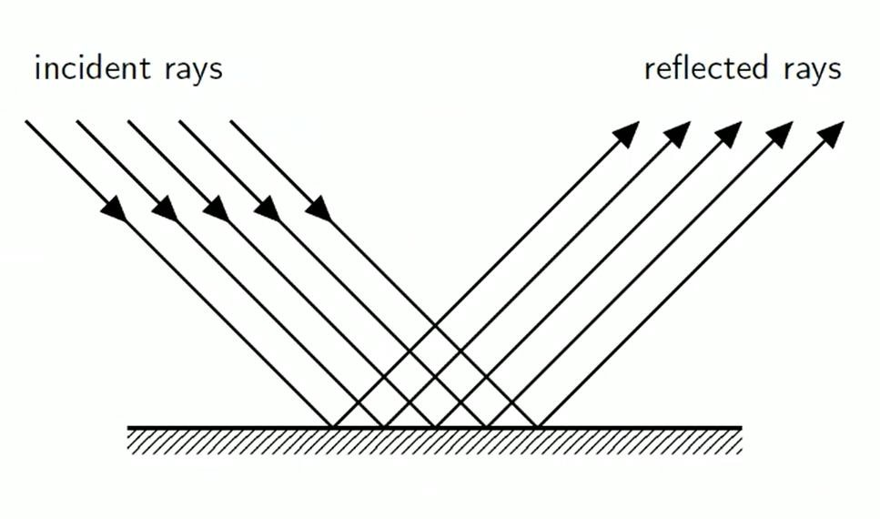
Specular Reflection

Slide 22
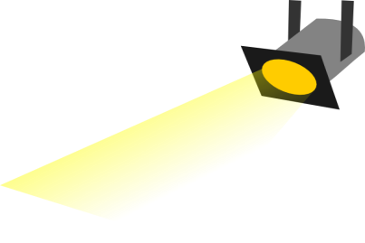
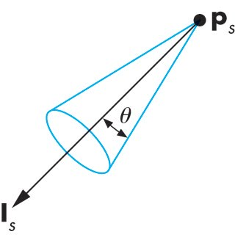
Spot Light
Spotlight is a point source that emits light in restricted set of directions,
Requires color, point, direction, falloff parameter
usually direction boundary forms a cone shape.
Here θ is Cut Off Cone. No light is seen at points lying outside Cutoff angle.
Intensity falls off directionally

Slide 23
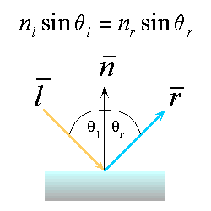
Ideal Specular Reflection
Reflection is only at mirror angle. An ideal mirror is a purely specular reflector.
View dependent reflection. That is, reflected light’s intensity varies with viewer’s position.
Intensity of reflected light is stronger near mirror angle and strongest at mirror angle.
An Ideal specular reflection follows Snell’s Law.
Snell’s Laws:
The incoming ray and reflected ray lie in a plane with the surface normal
The angle that the reflected ray forms with the surface normal equals the angle formed by the incoming ray and the surface normal

Slide 24
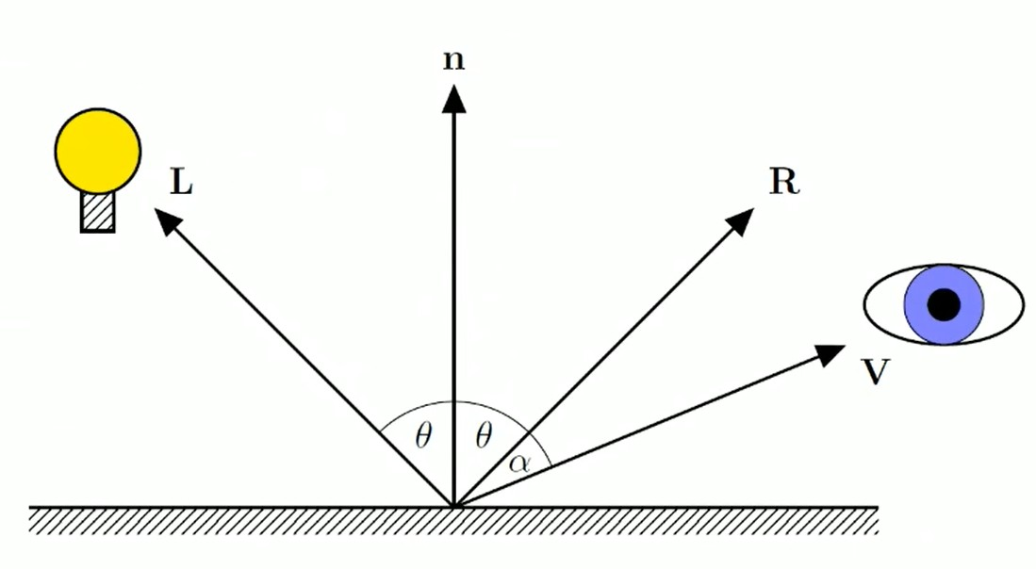
Specular Reflection

Slide 25
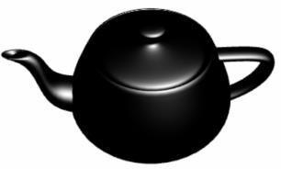
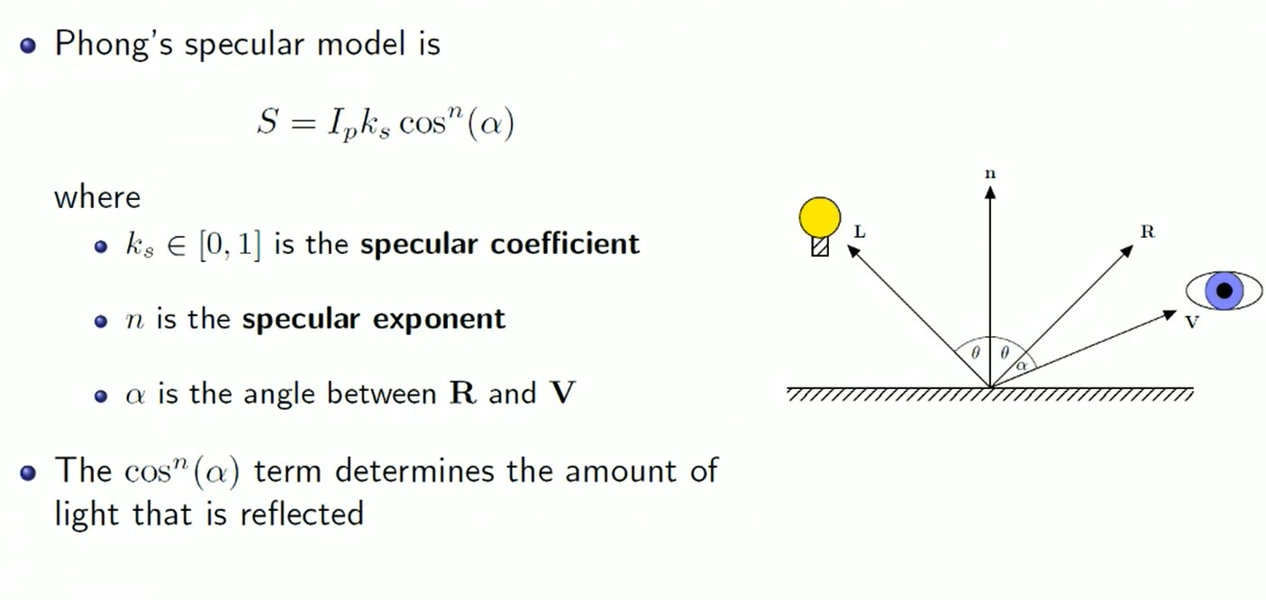
Specular Reflection
/Shininess

Slide 26
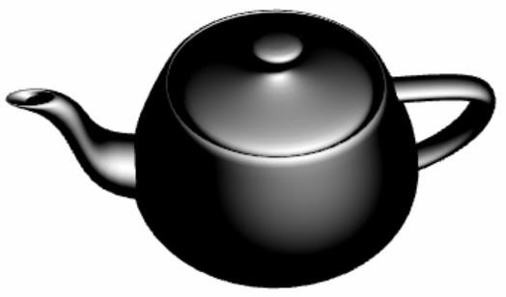
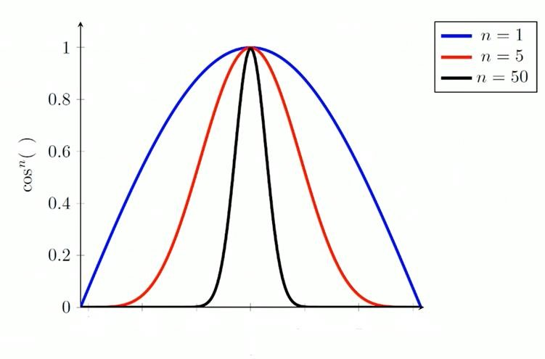
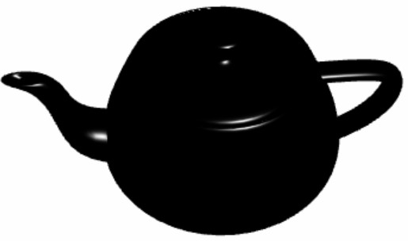


Specular Reflection
Shininess
Specular Coefficient - Determines Specular Light Intensity
Shininess Factor - Determines Surface Smoothness

Slide 27



Specular Reflection
H
Calculate R,

Slide 28
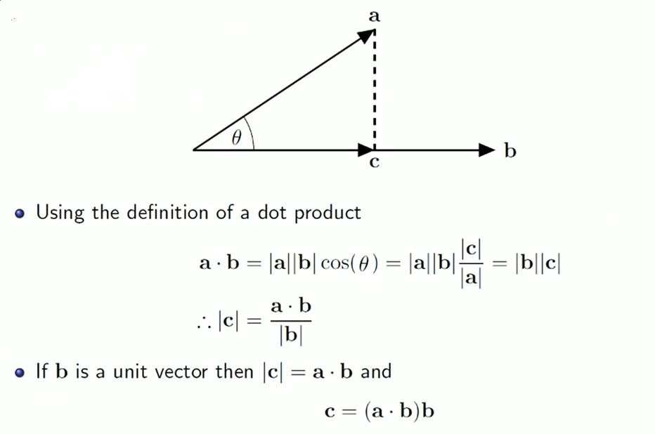

Slide 29
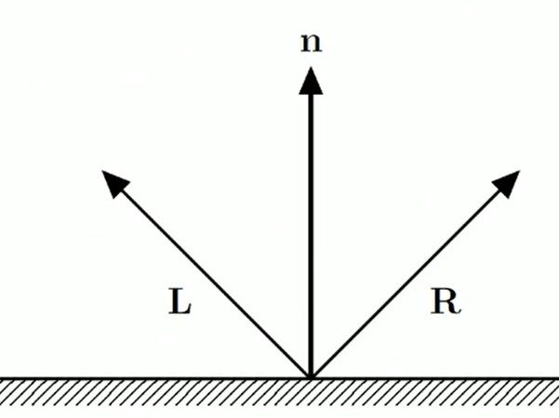
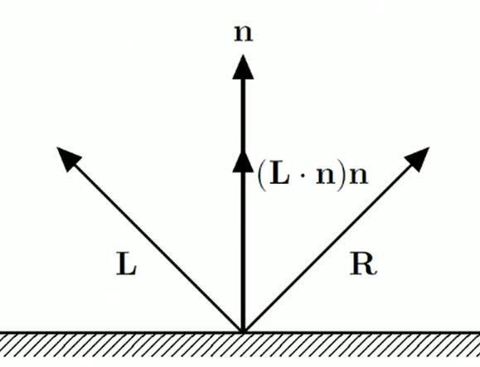
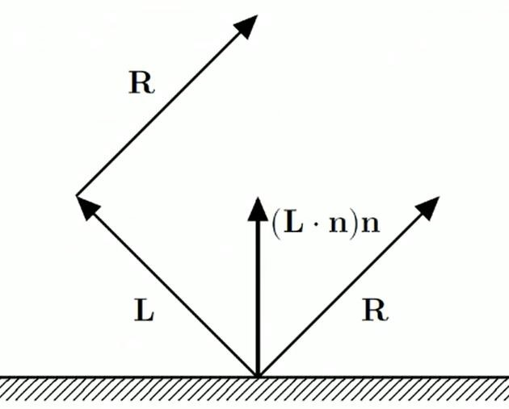
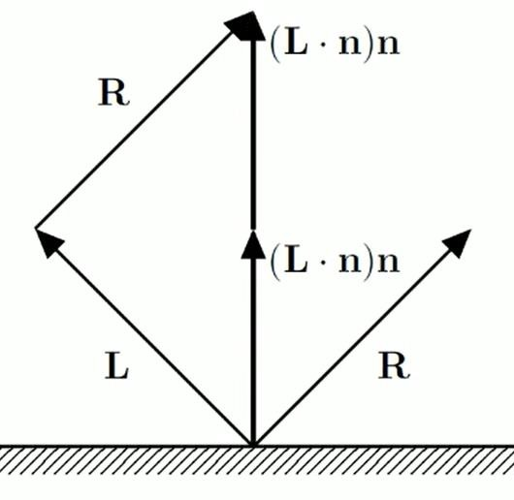
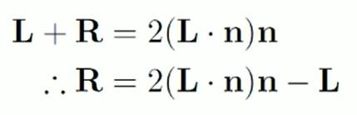
Here L and n are both unit vectors

Slide 30
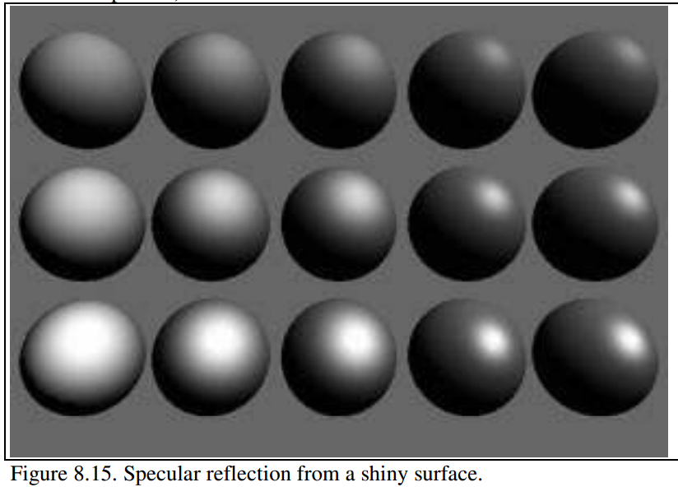
Specular Reflection Coefficient
The ambient and diffuse reflection coefficients are 0.1 and 0.4 for all spheres.
I_{d} = I_{s} k_{s} (cos φ)^{k}
More shiny and more highly concentrated along the direction r
Exponent, k
3
6
9
25
200
More mirror like, more focused reflection with increasing exponent
0.25
reflection coefficient, k_{s}
0.5
0.75
Notes:
As k increases, the reflection becomes more mirror-like and is more highly concentrated from left to right
The reflection coefficient ks varies from top to bottom with values 0.25, 0.5, and 0.75
exponent: user-chosen value that controls the apparent smoothness of the surface.

Slide 31
Blinn and Torrence Variation
Calculation of R is computationally expensive. So in phong model the term R.V is sometimes replaced by N.H , where H is a unit vector that bisect the angle between L and V.
angle between N and H measures the falloff of intensity.
Though calculation of N.H is is computationally inexpensive relative to R.V, but N.H is not always equal to R.V. In that case calculation of specular component will be approximate.
(See Solved Problem 11.11 in Schaum(2nd edition)))

Slide 32
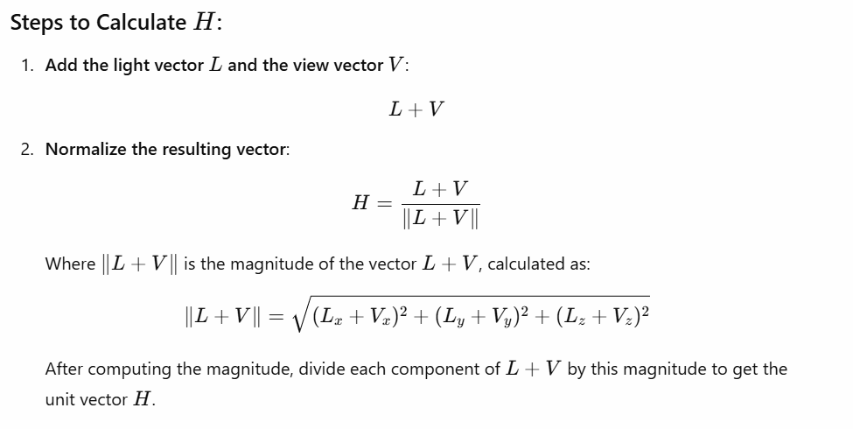
Here L and V are both unit vectors

Slide 33


Phong’s Reflection Model
I_{a}k_{a} + I_{p} [k_{d} max {(L.N),0} + k_{s} max{(R.V or N.H) ,0}^{k}] = I
Here all are unit vectors

Slide 34
Mathematical Calculation of Phong Model
We need to incorporate the effect light present in environment. Thus total reflected light also includes ambient component.
Ambient Component = I_{a}k_{a}
Total reflected light intensity from Q,
I = Ambient Component + Diffuse Component + Specular Component
= I_{a}k_{a} + I_{p} k_{d} (L.N) + I_{p} k_{s} (R.V)^{k}
More specifically,
I = I_{a}k_{a} + I_{p} [k_{d} max {(L.N),0} + k_{s} max{(R.V),0}^{k}]

Slide 35
Additional Issues
When there are n light sources in the scene, their effects are cumulative: Intensity at Q,
I = I_{a}k_{a} + ∑_{(i=1 to n)} I_{pi} {k_{d} (L_{i}.N) + k_{s} (R_{i}.V)^{k} }
The intensity of red, green and blue component of reflected light,
I_{r} = I_{a}k_{ar} + I_{pr} k_{dr} (L.N) + I_{pr} k_{s} (R.V)^{k}
I_{g} = I_{a}k_{ag} + I_{pg} k_{dg} (L.N) + I_{pg} k_{s} (R.V)^{k}
I_{b} = I_{a}k_{ab} + I_{pb} k_{db} (L.N) + I_{pb} k_{s} (R.V)^{k}
k_{s} : coefficient for specular component which is same as the color of light source, not affected by surface color.

Slide 36
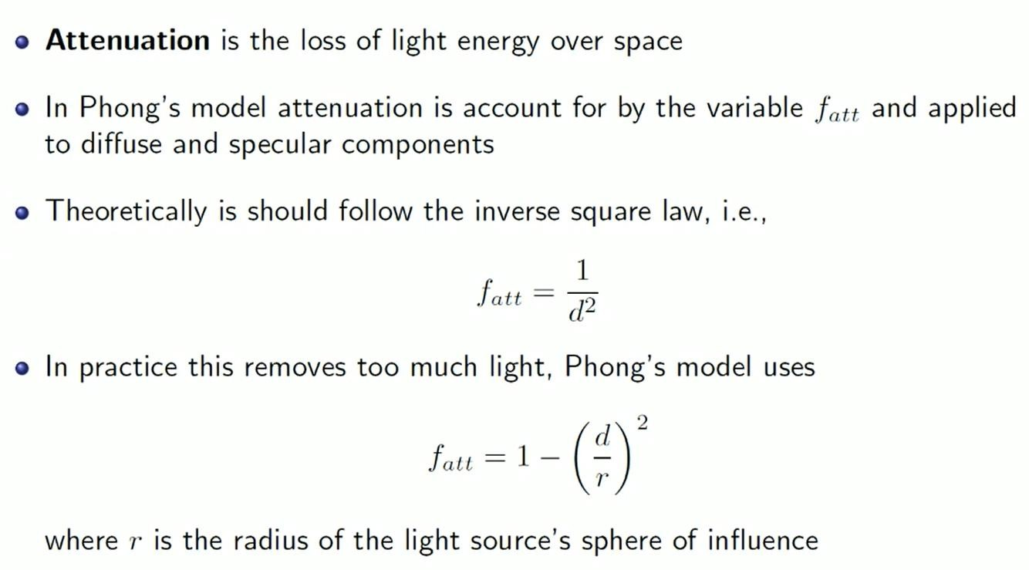

Attenuation
r

Slide 37
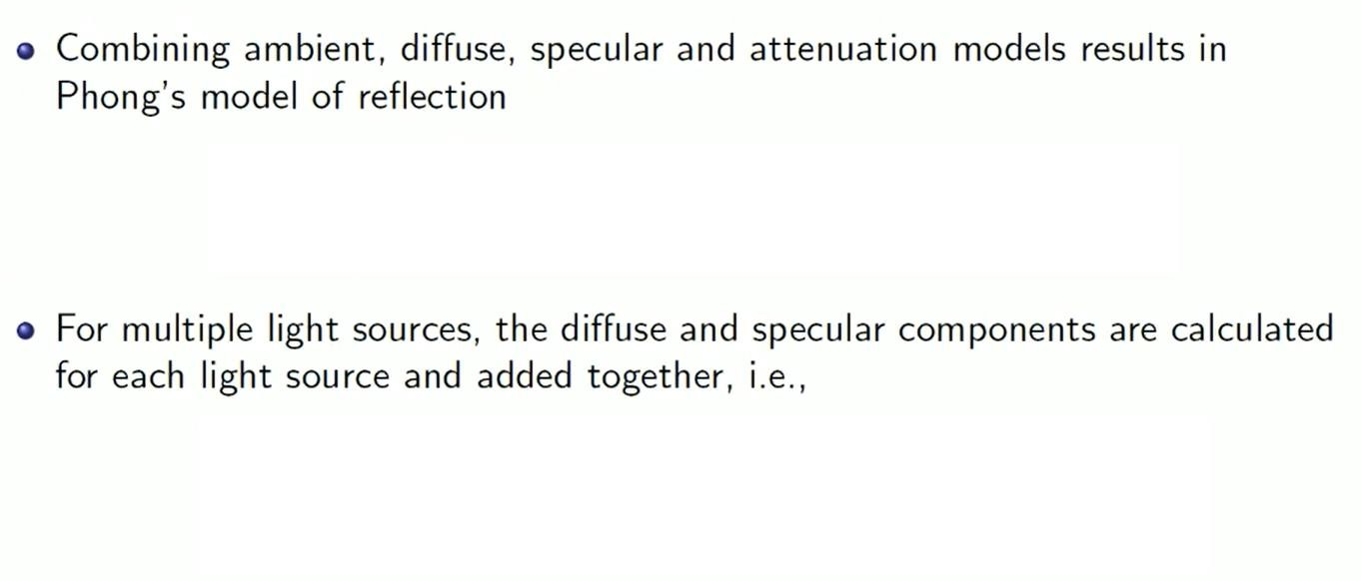
























asdasdasdasdasdadasdsadasdasdasdasdasdasdasdasdasdasdasdasdasdasdsasadasdadasdasdadasdasdas
I = I_{a}k_{a} + I_{p} f _{att} [k_{d} max {(L.N),0} + k_{s} max{(R.V),0}^{k}]
I = I_{a}k_{a} + ∑_{(i=1 to n)} I_{pi} f _{att-i} {k_{d} (L_{i}.N) + k_{s} (R_{i}.V)^{k} }

Slide 38
Exercise
A light source with intensity 15 and radius of influence 80 is located at (4,2,3) from which you are called to calculate the illumination of a point on the xz plane. The camera is set at origin and the light is reflected back from point (0, 4) of the plane. The ambient, diffuse and specular coefficient is given at 0.4, 0.2, 0.3.
For the above phenomenon, represent the reflected ray R in the unit vector.
Calculate the specular reflection intensity for a shininess factor of 99.
Calculate the attenuation factor for the given point in the above scenario.
If the ambient light intensity is at 2, calculate the total reflected light intensity at the given point according to phong’s model with the attenuation factor.

Slide 39
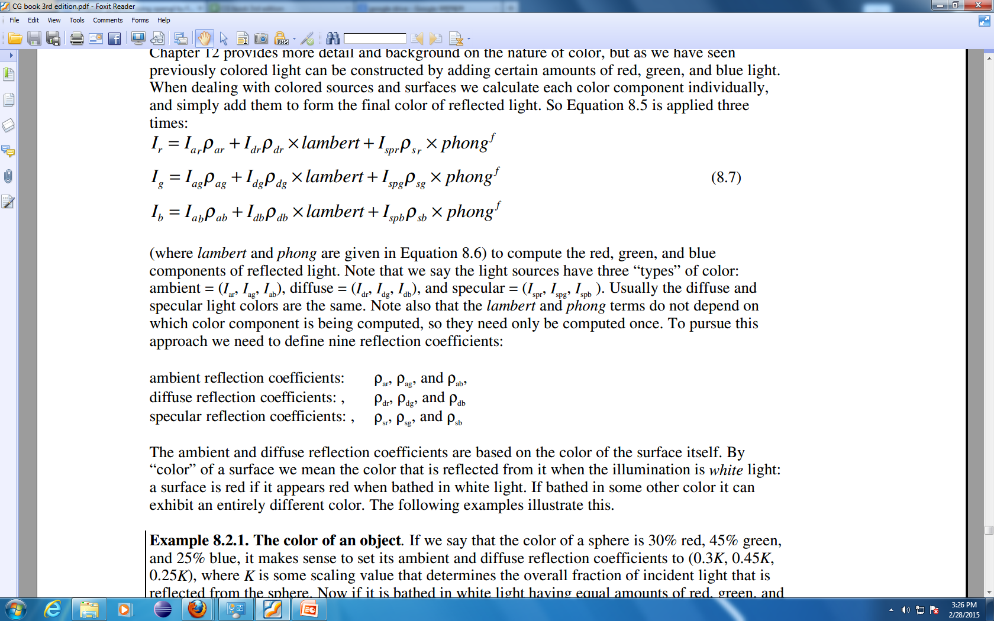
Color
Color is constructed by adding certain amounts of red, green, and blue light
Light sources have three “types” of color:
Surface has two sets of reflection coefficient
Ambient reflection coefficient : k_{ar} , k_{ag} , k_{ab}
Diffuse reflection coefficient : k_{dr} , k_{dg} , k_{db}
Color of the specular component is often the same as that of the light source – mirror like, so the specular reflection coefficient: k_{sr} , k_{sg} , k_{sb} = k_{s}
e.g. Glossy red apple when illuminated by a yellow light is yellow rather than red

Slide 40
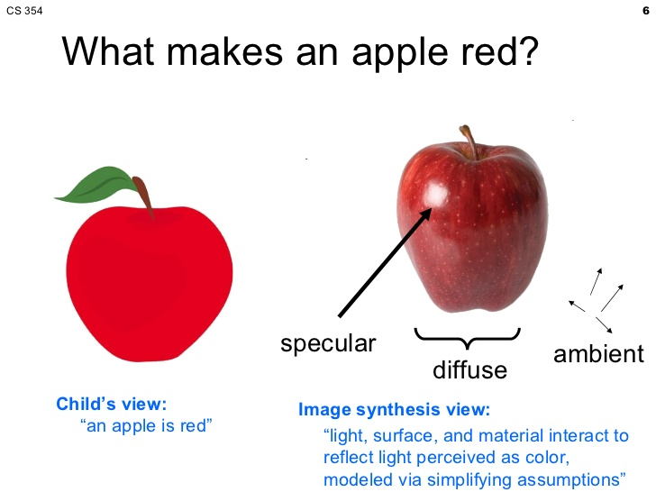
Color of an Object

Slide 41
Color of an Object
By “color” of a surface we mean the color that is reflected from it when the illuminated by white light
The ambient and diffuse reflection coefficients are based on the color of the surface itself.
The specular reflection coefficient is based on the color of the light source (and the roughness property of the surface)
Notes:
A surface is red if it appears red when bathed in white light. If bathed in some other color it can exhibit an entirely different color.

Slide 42
Color of an Object
Color of a sphere is 30% red, 45% green, and 25% blue
Light source in environment: Monochrome light (Intensity : I_{sr}= I_{sg}= I_{sb} = I_{s})
Sphere’s ambient and diffuse reflection coefficients: k_{ar} = k_{dr}= 0.30k k_{ag}= k_{dg}= 0.45k k_{ab}= k_{db}= 0.25k
here, k is some scaling value
The individual ambient and diffuse components have intensities I_{ar}= 0.30k I_{a} , I_{dr}= 0.30k I_{s} cosθ I_{ag}= 0.45k I_{a} , I_{dg}= 0.45k I_{s} cosθ I_{ab}= 0.25k I_{a} , I_{ab}= 0.25k I_{s} cosθ
If the environment is uniformly lighted, θ = 0⁰ for sphere!!
Notes:
K is some scaling value that determines the overall fraction of incident light that is reflected from the sphere

Slide 43
Shading
The process of assigning colors to pixels.
Shading
Flat Shading
Smooth Shading
Gouraud Shading
Phong Shading

Slide 44
Shading Model
Flat Shading
Compute Phong lighting once for entire polygon
Gouraud Shading
Compute Phong lighting at the vertices and interpolate lighting values across polygon
Phong Shading
Interpolate normals across polygon and perform Phong lighting across polygon

Slide 45
Flat Shading
For each polygon
Determines a single intensity value at a chosen point on the polygon
Uses that value to shade the entire polygon
Assumptions
Light source at infinity
Viewer at infinity
The polygon represents the actual surface being modeled

Slide 46
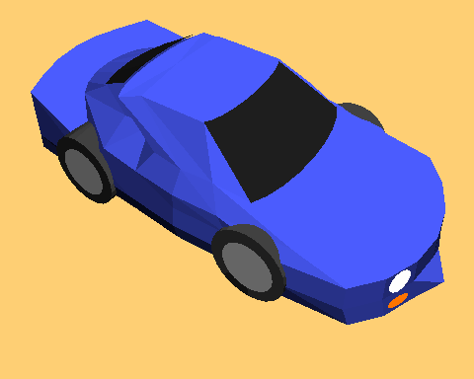
Problems of Flat Shading
Specular highlights tends to get lost
If chosen point on polygon is at location of the light source, then color of the polygon will be significantly distorted.
Flat Shading

Slide 47
Shading
The process of assigning colors to pixels.
Shading
Flat Shading
Smooth Shading
Gouraud Shading
Phong Shading

Slide 48
Shading Model
Flat Shading
Compute Phong lighting once for entire polygon
Gouraud Shading
Compute Phong lighting at the vertices and interpolate lighting values across polygon
Phong Shading
Interpolate normals across polygon and perform Phong lighting across polygon

Slide 49
Flat Shading
For each polygon
Determines a single intensity value at a chosen point on the polygon
Uses that value to shade the entire polygon
Assumptions
Light source at infinity
Viewer at infinity
The polygon represents the actual surface being modeled

Slide 50
Problems of Flat Shading
Specular highlights tends to get lost
If chosen point on polygon is at location of the light source, then color of the polygon will be significantly distorted.
Flat Shading

Slide 51
Smooth Shading
Introduce vertex normals at each vertex
Used only for shading
Think of as a better approximation of the real surface that the polygons approximate
Finds color value for each point in the polygon individually
Two types
Gouraud Shading
Phong Shading (do not confuse with Phong Lighting Model)

Slide 52
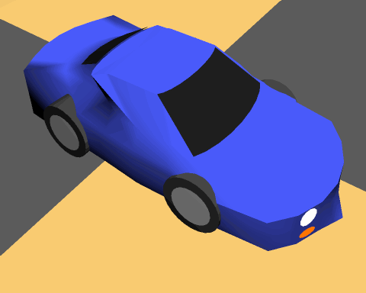
Gouraud Shading
Most common approach
Perform Phong lighting at the vertices
Linearly interpolate the resulting colors over faces
Along edges
Along scanline

Slide 53
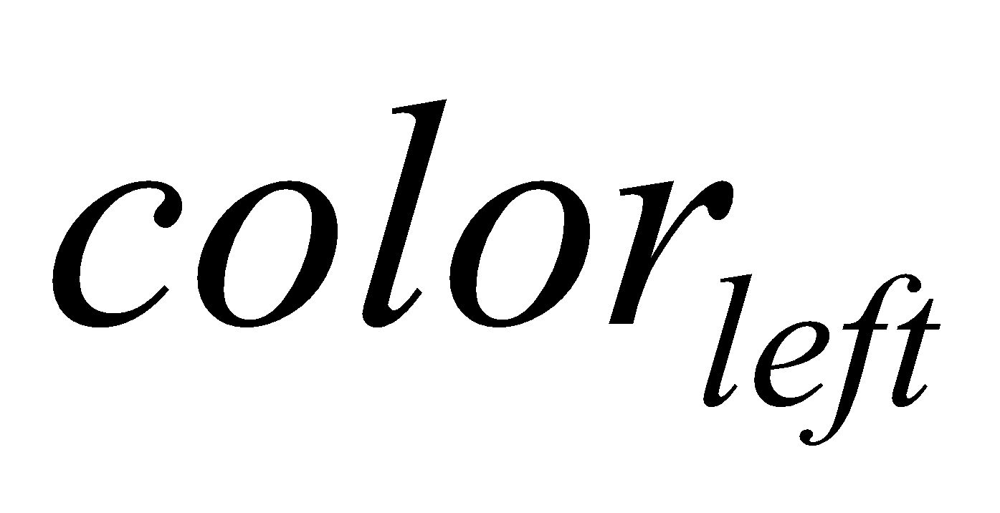
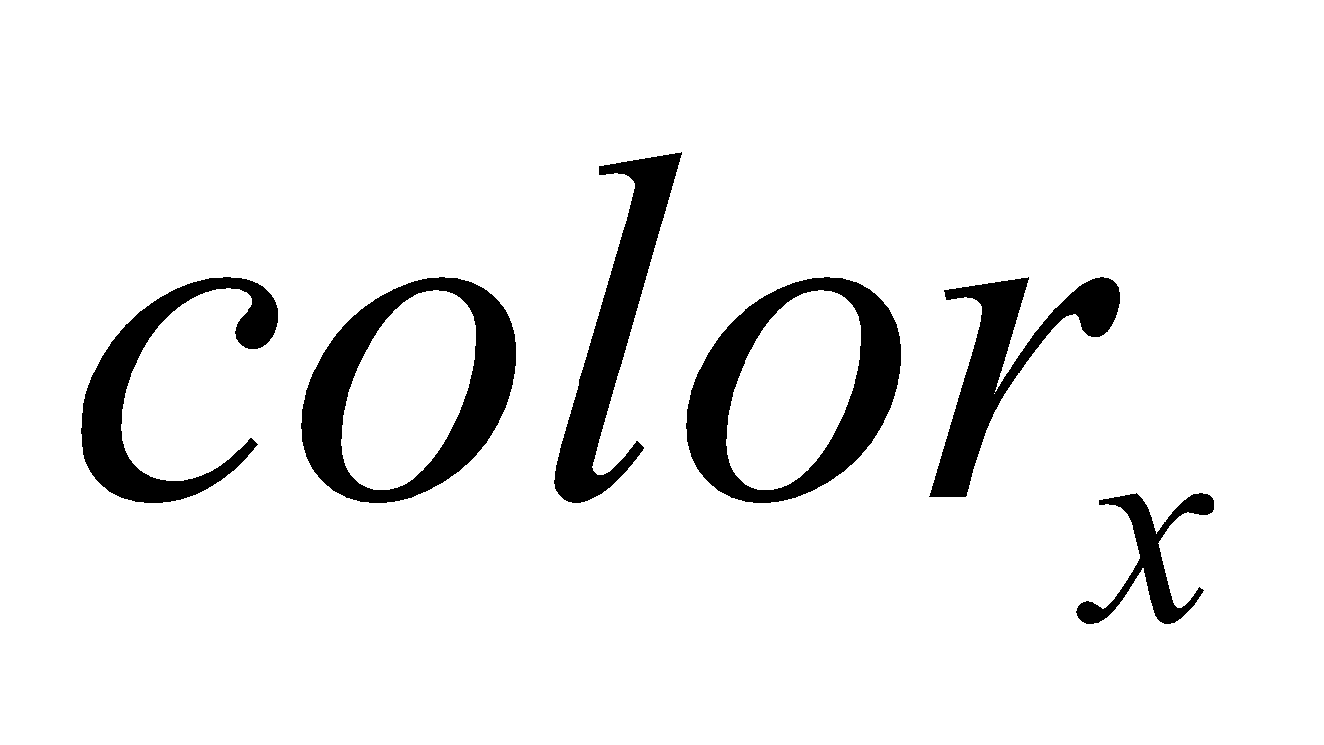
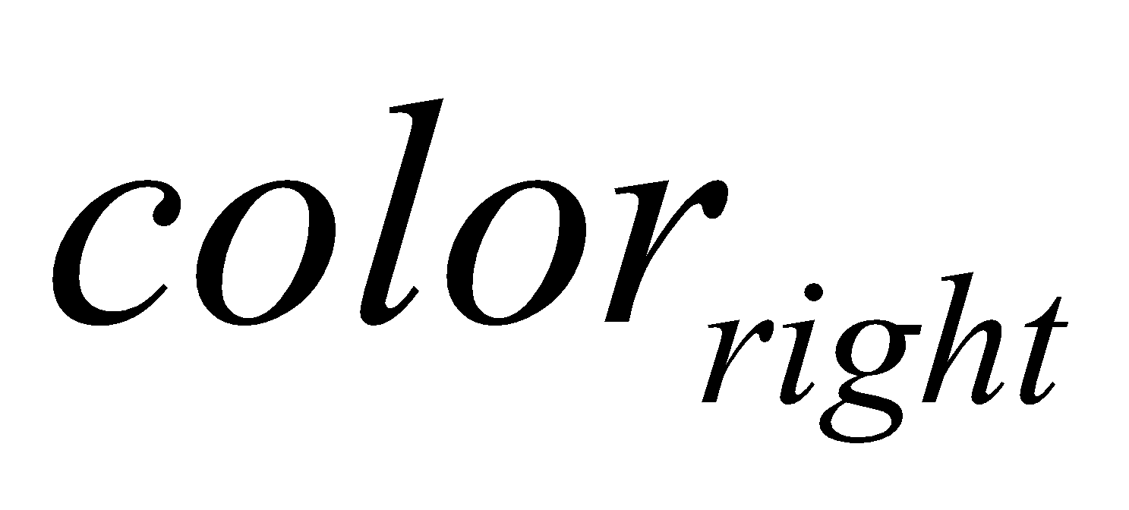
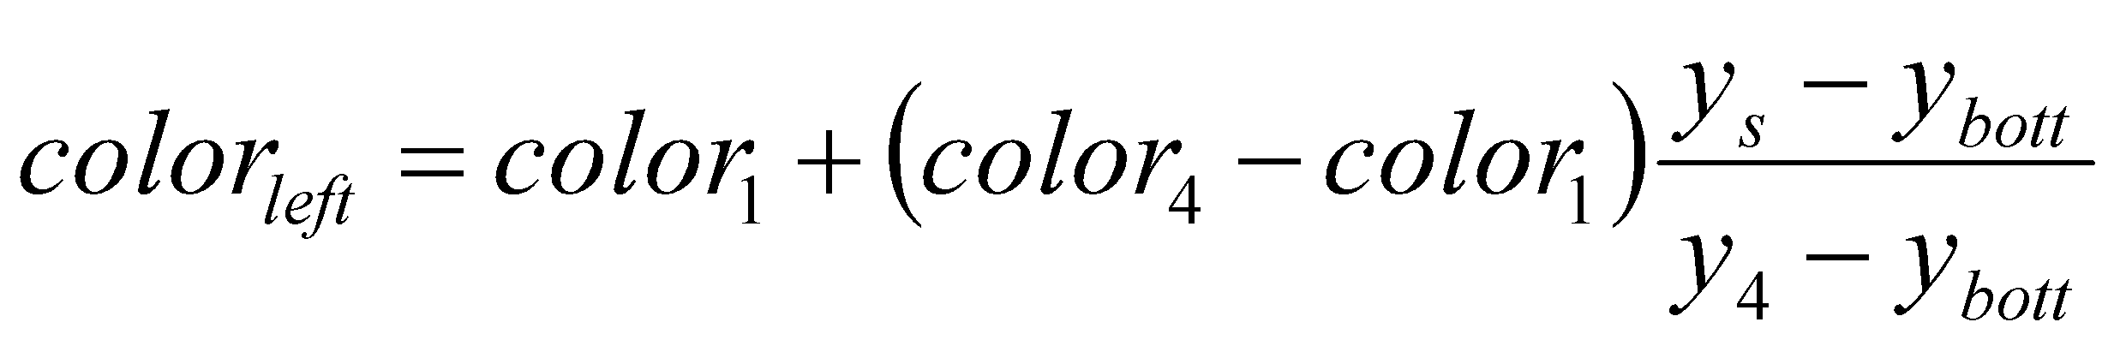
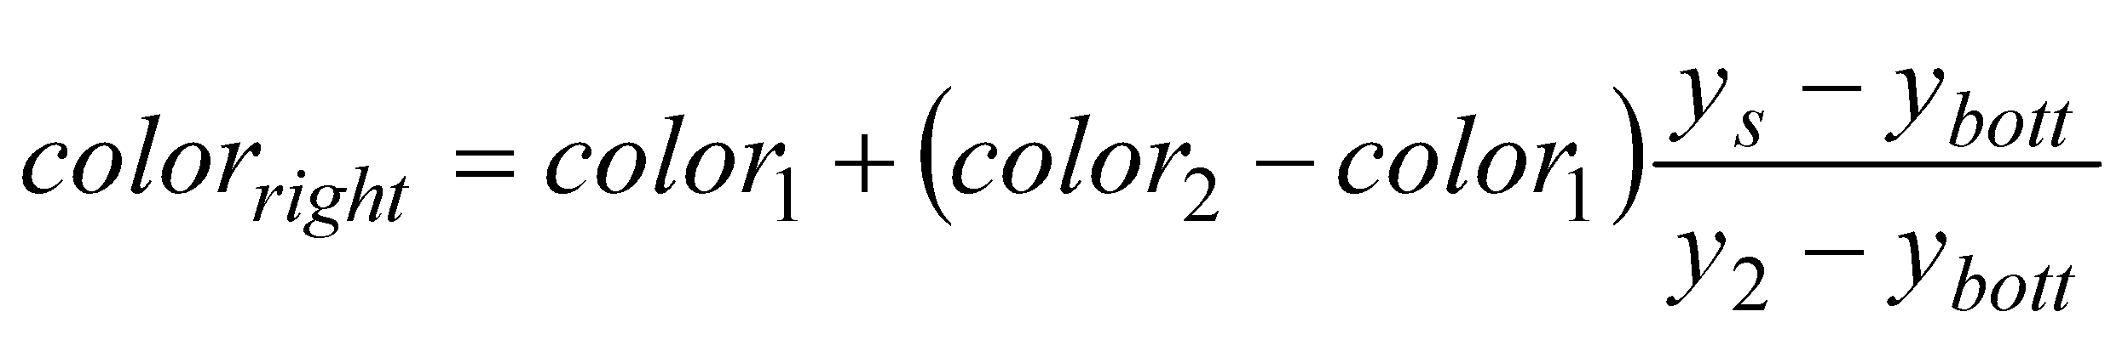
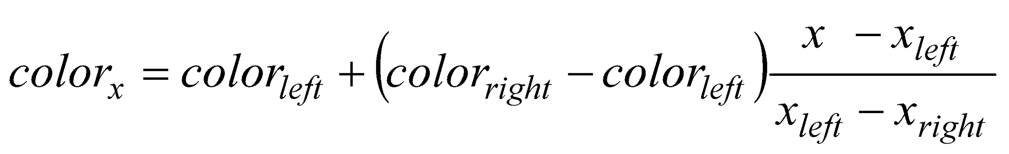
Gouraud Shading
y_{top}
color₃
y₄
color₄
color₂
y_{s}
y_{bott}
color₁
x_{left}
x_{right}
X_{right}- X_{left}

Slide 54
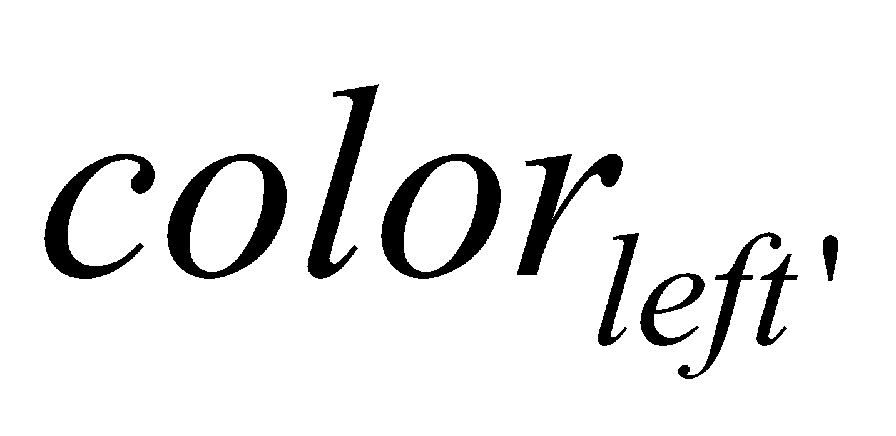
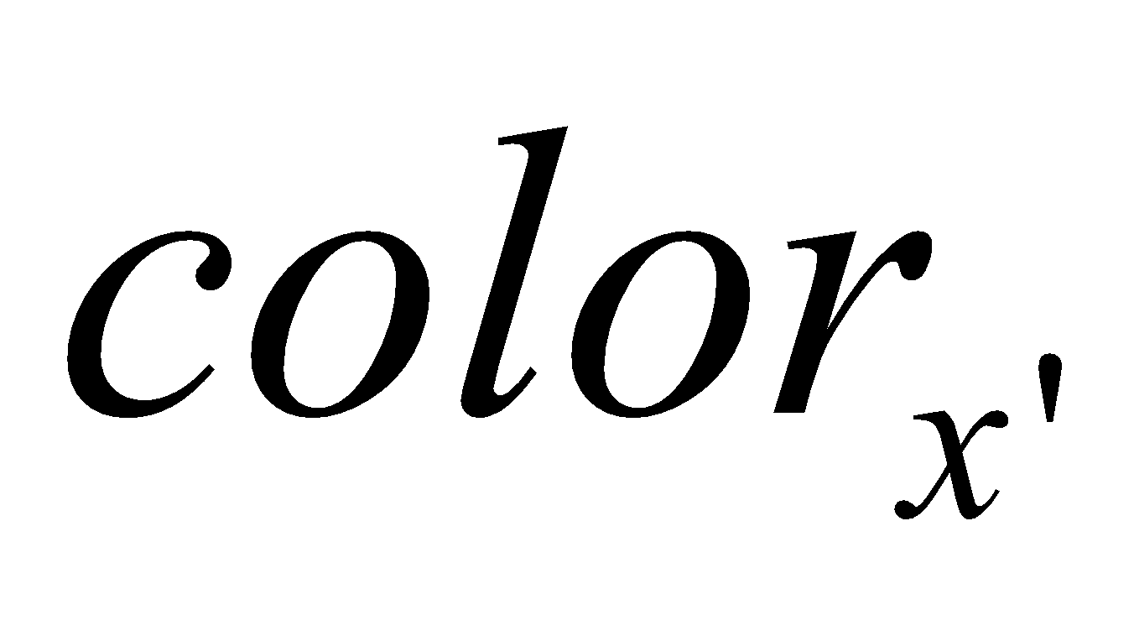
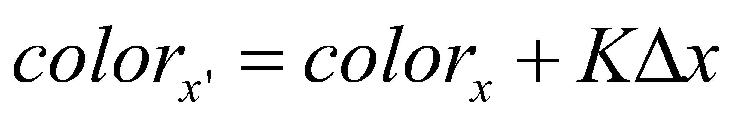

Gouraud Shading
y_{top}
color₃
y₄
color₄
color₂
y_{s}
y_{bott}
color₁
x_{left}
x_{right}
X_{right}- X_{left}
Calculate the surface normals along the scan line and the edge using incremental approach

Slide 55
Problem of Gouraud Shading
Often appears dull
Lacks accurate specular component
C₁
C₃
C₂
Can’t shade the spot light

Slide 56
Phong Shading
Interpolate normal vectors of face vertices at each pixel, then perform Phong lighting at each pixel.
m₃
y_{s} - y₁
m_{left} = m₁ + (m₄-m₁)
m₄
m₂
m_{left}
m_{right}
Y₄ - y₁
m_{x}
y_{s} - y₁
y_{s}
m_{right} = m₁ + (m₂-m₁)
m₁
Y₂ - y₁
x - x_{left}
x
m_{x}= m_{left} + (m_{right} - m_{left})
x _{right} - x_{left}
Calculate the surface normals along the scan line and the edge using incremental approach

Slide 57




Phong vs Gouraud Shading
Phong shading is more smooth
If a highlight does not fall on a vertex, Gouraud shading may miss it completely, but Phong shading does not.

Slide 58
Reference:
Computer Graphics: Principles and Practice: John F. Hughes, James D. Foley, Andries van Dam, Steven K. Feiner (2nd Edition)
Chapter: 16.1.1 - 16.1.4, 16.1.6, 16.2.1 - 16.2.5

Slide 59
Exercise
Check this link:
https://docs.google.com/document/d/1cHl5OCODvXEnMRGf0Md6KngfJU2xoUPT25IyD75VOO4/edit?tab=t.z452h0s9cioq

